Slide 1
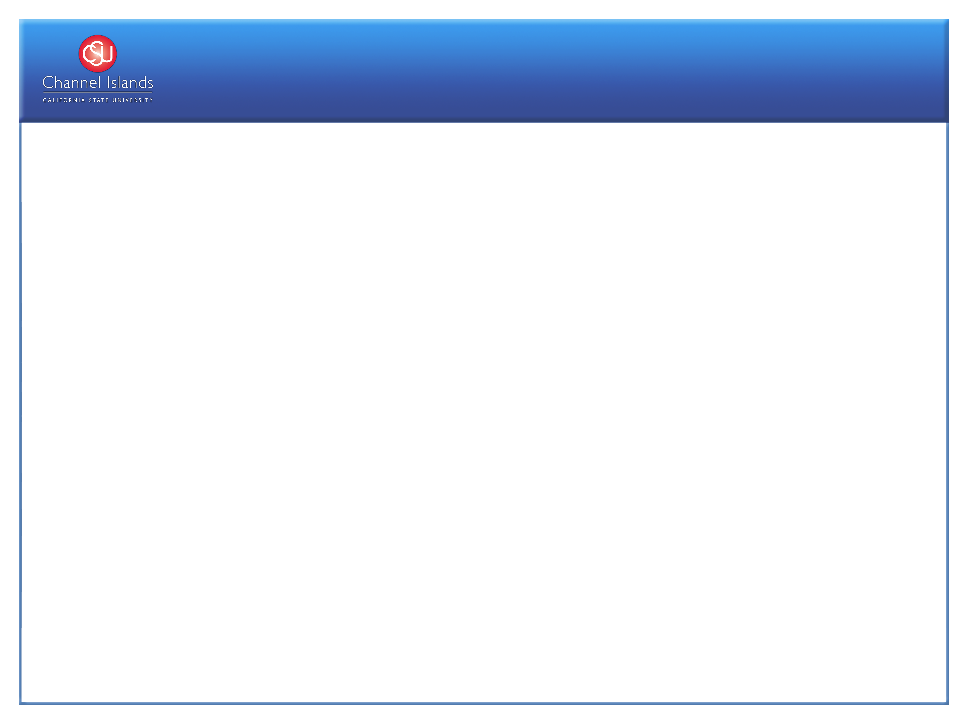
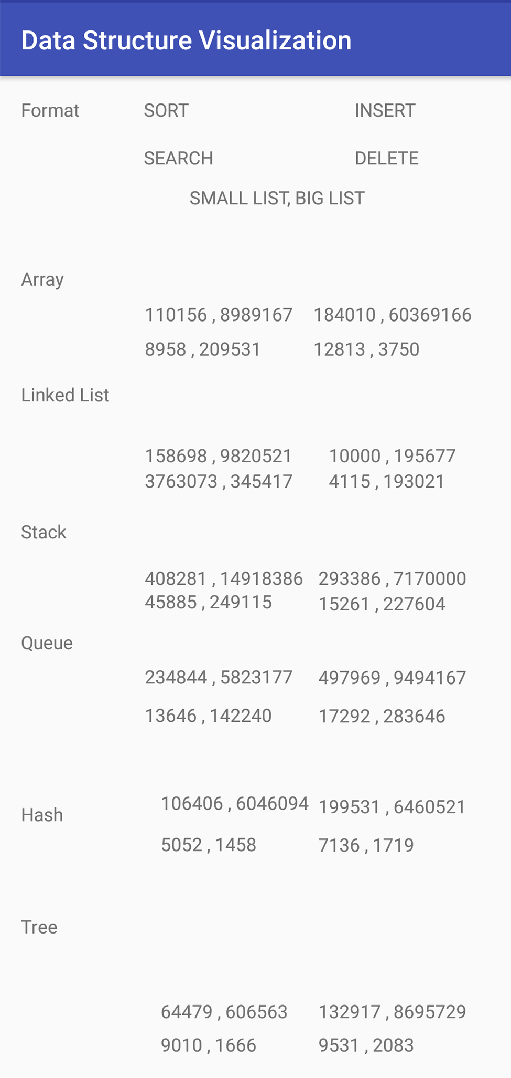
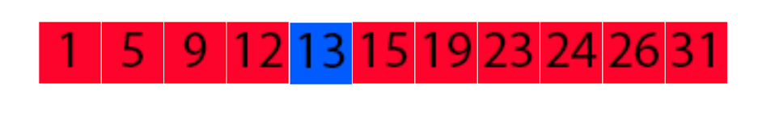
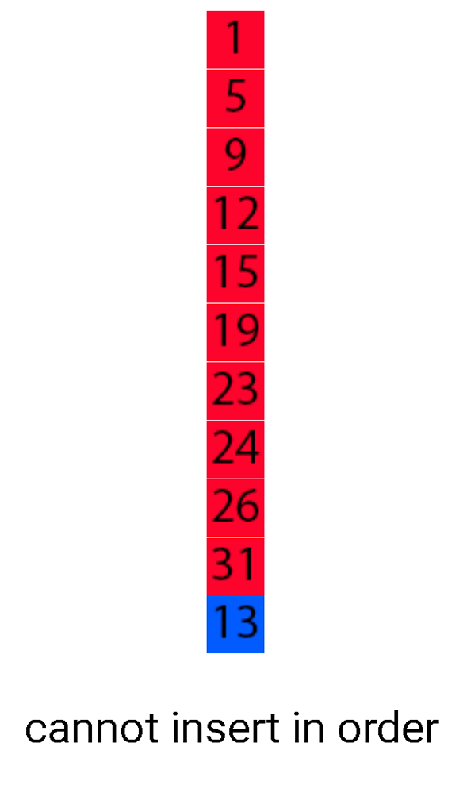
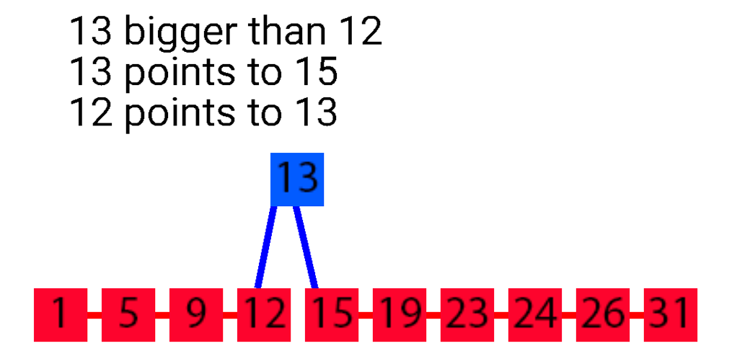
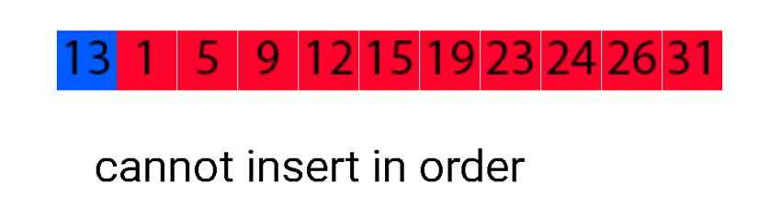
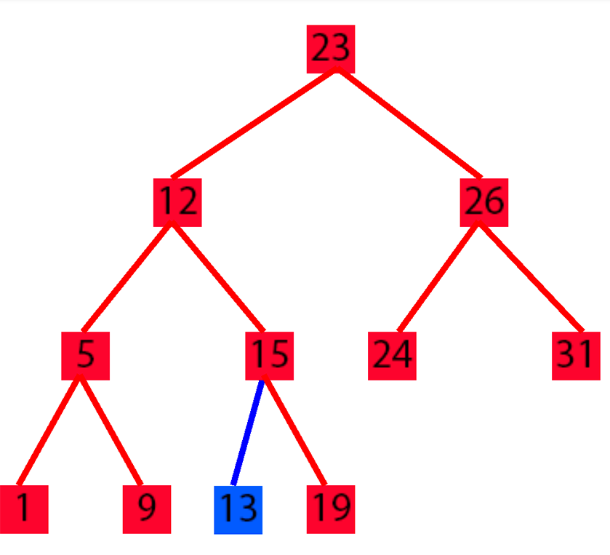
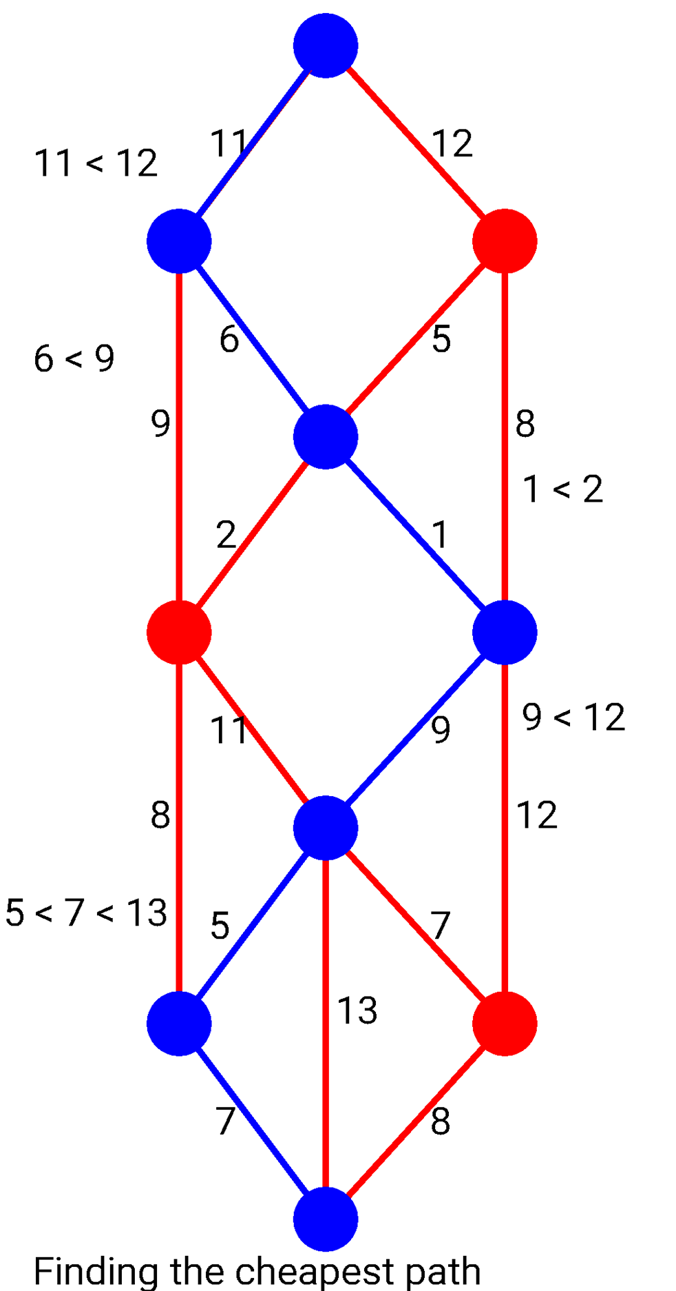
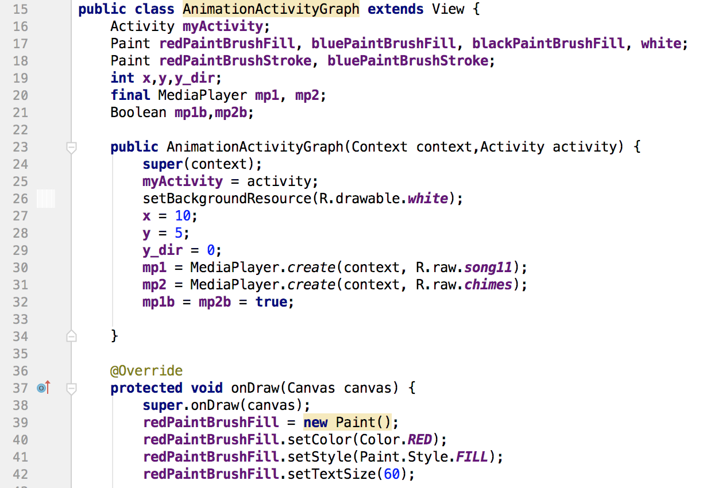
Data Structure Visualization
Mitchell Dennen • David Claveau • Comp 499-02
Introduction
Results
Is there an easy way to visualize data structures and their operations?
The main data structures we learn about are:
-Arrays
-Linked Lists
-Stacks
-Queues
-Hashes
-Trees
-Graphs
Data Structure Visualization is an app that helps students visualize operations for each data structure.
Visualizing how data moves around in a data structure is essential to understanding how to implement a particular algorithm.
The idea came about when I was thinking back to learning about each data structure and the difficulty I was having understanding them.
Conclusion
Methodology
This project was a valuable experience for me for a few reasons:
-It was a great review of the core data structures I learned
-It taught me many things about app development
-It prepared me for technical job interview questions
-It was the first time I tackled a large project by myself
-It taught me a lot about programming drawing and animation
Although I was not able to fit everything I wanted into this project, I am very happy with the product and look forward to improving it over time.
I used Android Studios to create a an app for the android operating system.
For each data structure animation I created a view class, where all the animation takes place on a canvas within the onDraw method.
Future of Data Structure Visualization
I would like to make animations for sorting, searching, and deleting for applicable data structures. I would also like a practical way for the user to view certain code segments for each data structure.
Acknowledgments
Professor David Claveau (Advisor)

